Slide 1


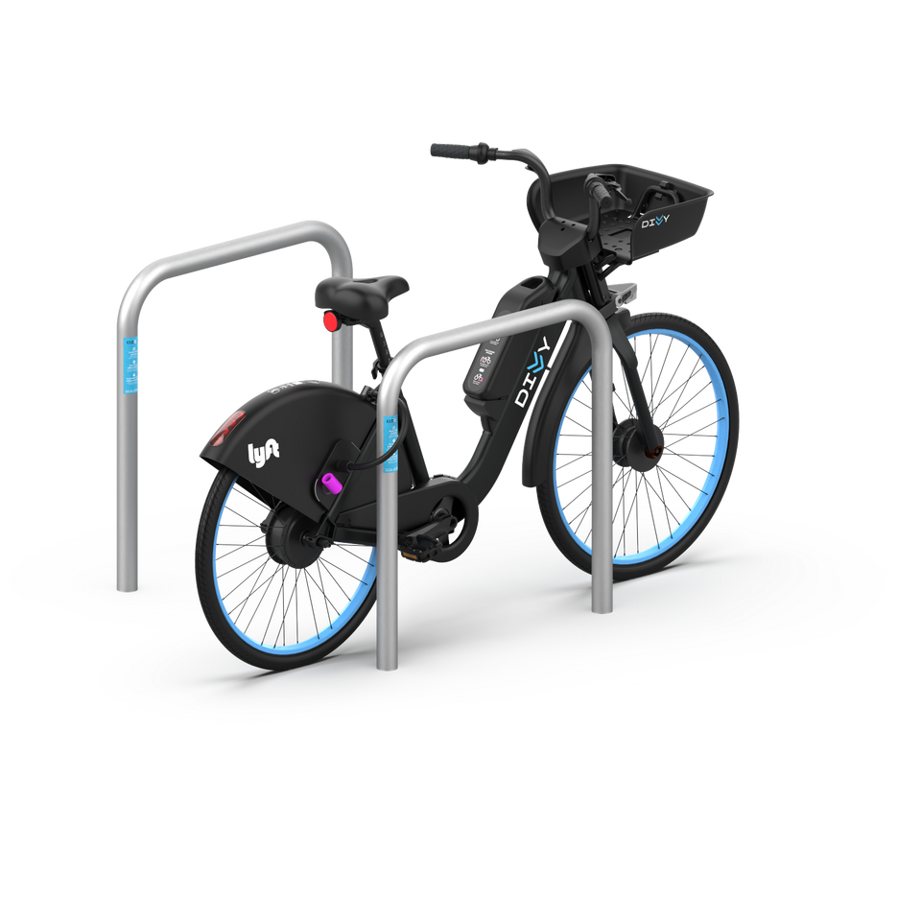

Utilizing Cyclistic's Historical Data for Marketing Strategies
GROUP 3
KRISTIAN BRILYAWAN
Farhan Trinanda Putra
Muhammad Tofik Hidayat
Ridho Aryawan
Adelia Januarto
YOGYAKARTA, 01 APRIL 2024

Slide 2


Introduction
01
02
03
Analysis objective:
We aim to understand customer behaviors and optimize marketing strategies in end-quarter for effective conversion.
Cyclistic operates a bike-share program across Chicago with nearly 6000 bicycles and 600 docking stations.
Business goal:
To convert casual riders into subscribers to increase profitability.
02

Slide 3


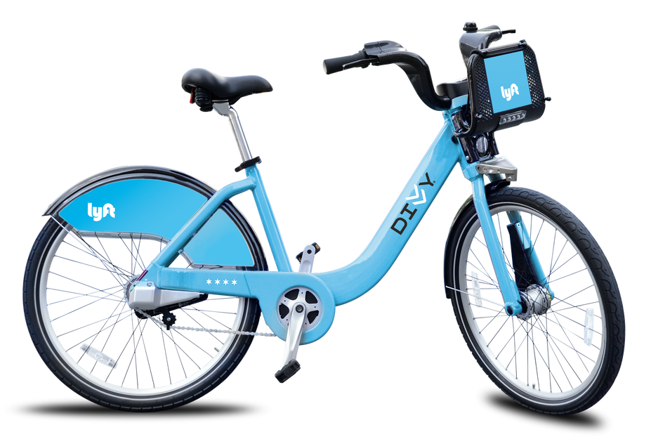
Data Preprocessing
We did not find any data duplications, some missing values around 15% of the total dataset.
03

Slide 4
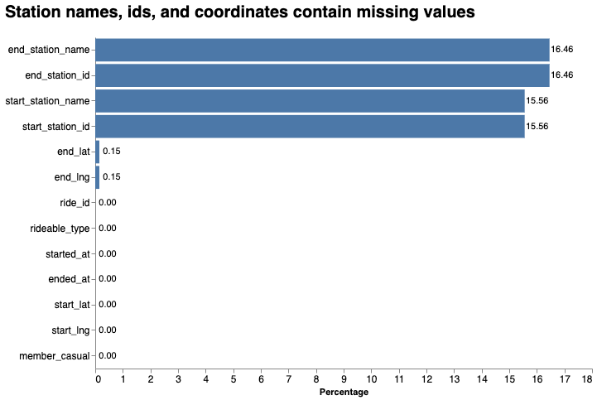
Approaches to Handle Missing Values
Drop for unused columns such as station id, lat, and lng. Fill missing values in station name with unknow_1, unknow_2, etc.
04

Slide 5
How are casual riders and subscribers different?
We observe distinct activity patterns of bike usage in Q3 2023
03

Slide 6
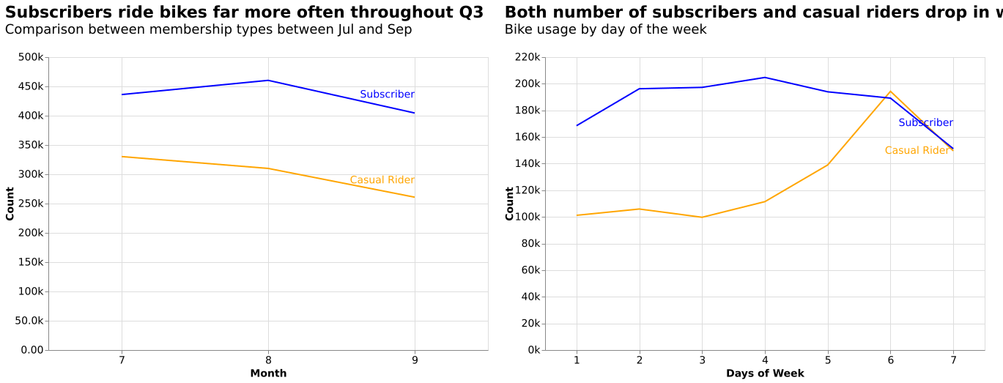
Difference of Monthly and Daily Usage
Subscribers consistently show higher activity levels compared to casual riders throughout Q3, 2023. And subscribers are more active on weekdays while casual riders are more active on weekends, but both decrease on Sundays
04

Slide 7
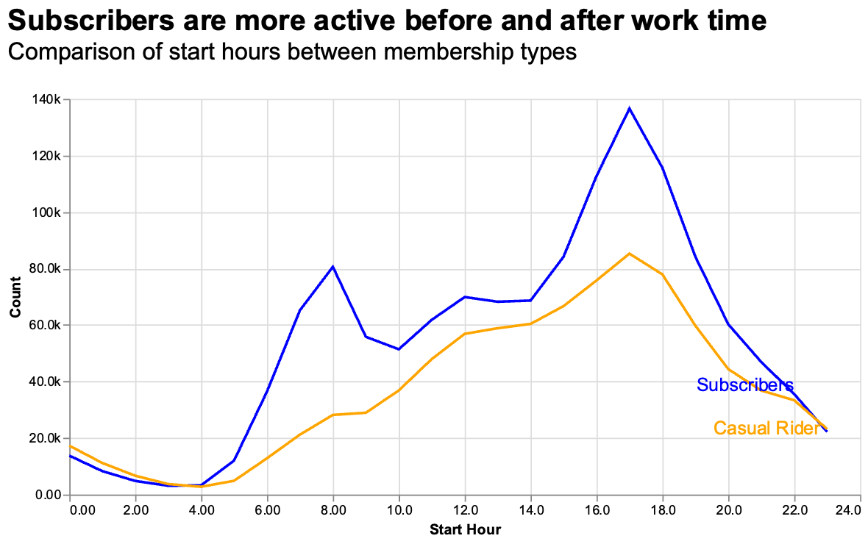
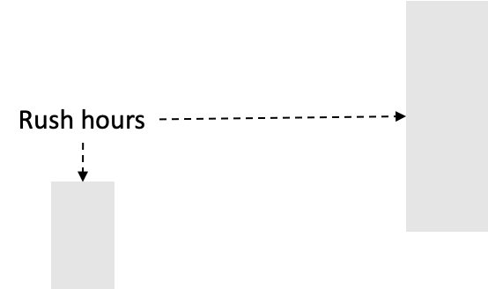
Difference of Time Patterns
Subscribers are most active in the morning, with peak activity in rush hours, while casual riders have a more consistent activity pattern throughout the day.
05

Slide 8
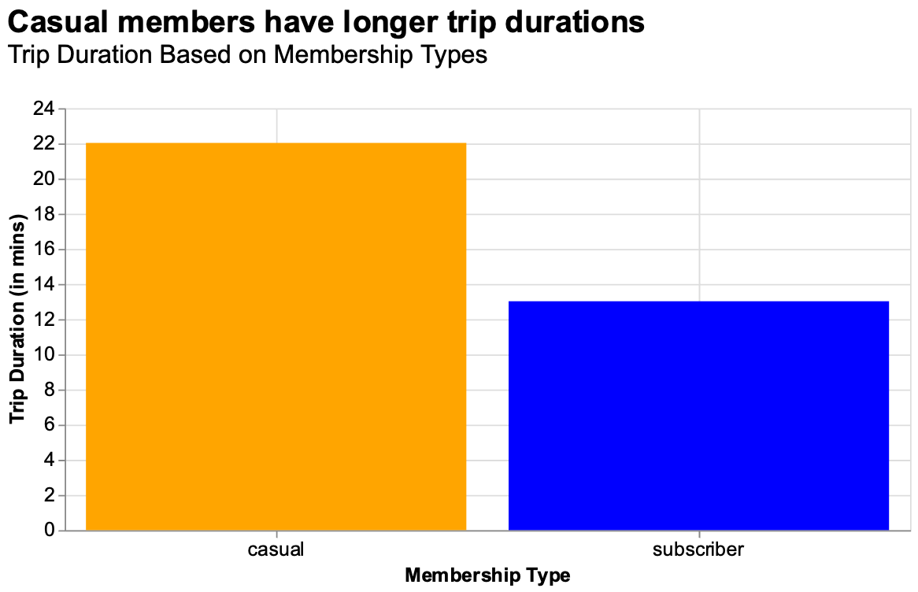
Difference of Trip Duration
Casual riders typically have longer trip durations, averaging 22 minutes per trip, compared to subscribers who have shorter trip durations averaging 13 minutes each.
22 min
13 min
06

Slide 9



Based on the usage patterns, we assume:
“We rest on Sunday!
Subscibers
Casual Riders
Workers and Students:
Active on weekdays and rush hours, short duration trips.
Only for recreations:
Low on weekdays, increase on weekends and high duration trips.
07

Slide 10
Why would casual riders buy a membership?
Pricing of annual membership is 2.7x more budget-friendly than that of non-membership
08

Slide 11
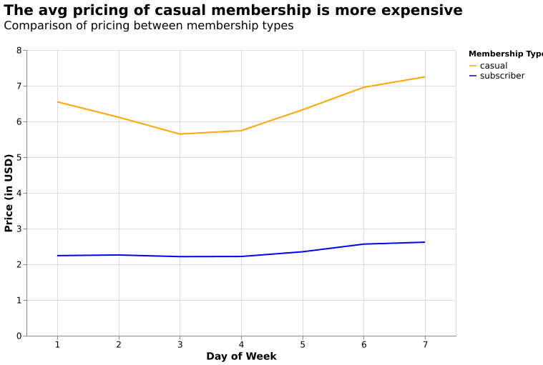
Perks of a membership for casual riders
Subscribers enjoy the benefit of consistently lower average pricing for bike rides throughout the week compared to casual riders.
The lower pricing in average means potential cost savings and underscores the perks of the subscription for frequent riders.
09

Slide 12
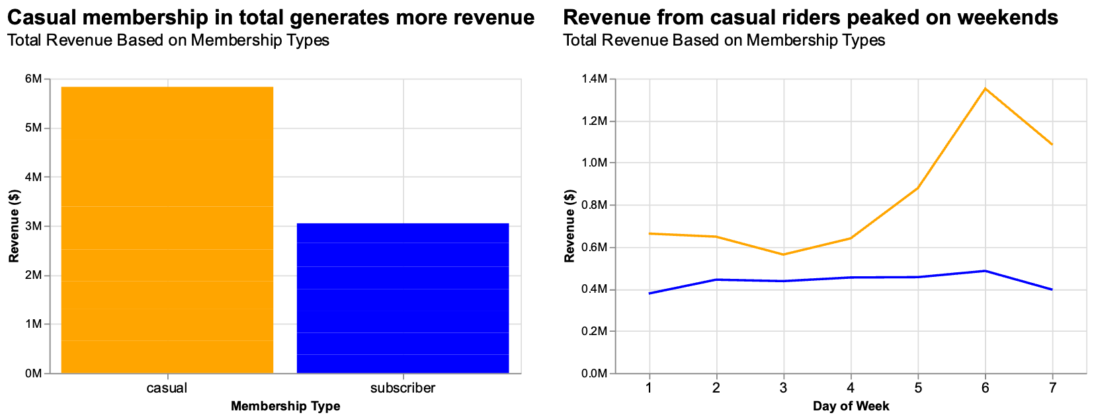
Perks of a membership for the company
Casual riders generate significantly more revenue compared to subscribers because of higher price, especially on the weekends, BUT…
Casual Rider
Subscribers
10

Slide 13
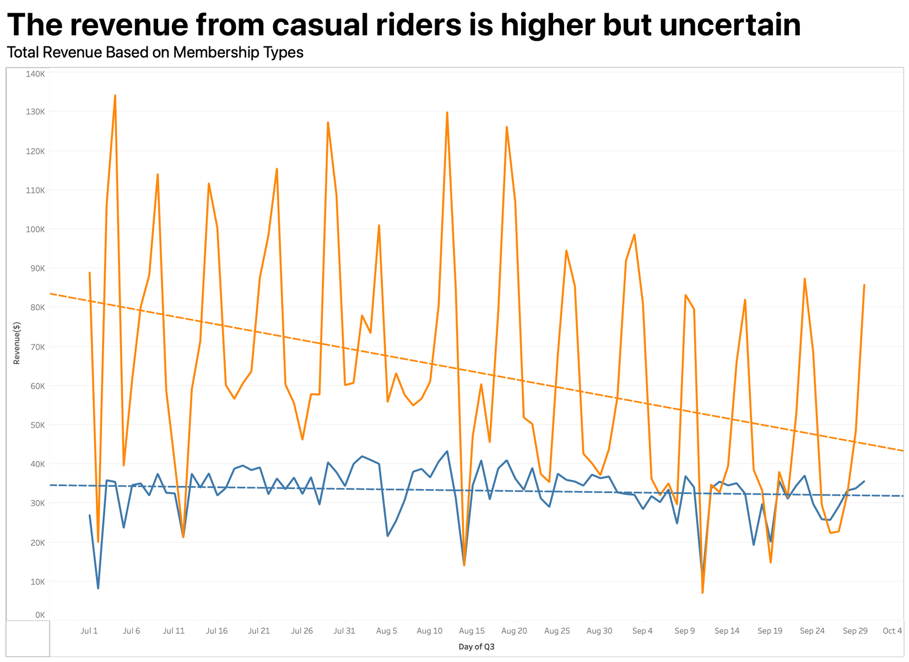
Perks of a membership for the company
This revenue from casual riders may not be sustainable because the school summer holiday (around Jun to early Sep) could affect the earnings.
Focusing more on conversion may be equally important as getting more new customers.
11

Slide 14
Understanding perks of membership for marketing
Understanding customer perks for choosing their membership is crucial for providing effective conversion strategies.
Subscribers can save more money with lower prices, making membership attractive for casual riders.
12

Slide 15
How digital media could affect our marketing tactics?
Customer characteristics can be used for optimizing personalized ads on social media platforms, thereby more efficient approach to convert potential customers
13

Slide 16
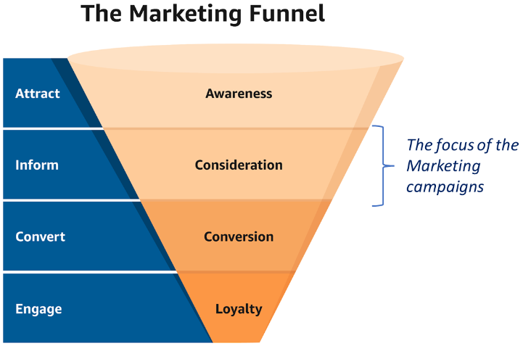
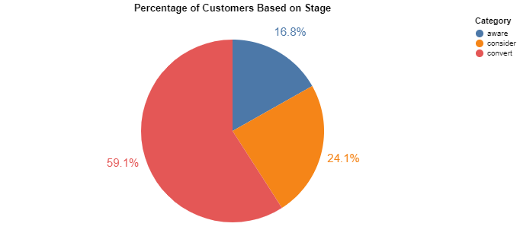
Leverage Customer Data to Make Personalized Ads
370K
1,300K
530K
Using our data, we can conclude that there are 3 types of customer:
1) Type Aware 2)Type Consider 3)Type Convert
There are still 24% Potential Market to convert to subscribers

Slide 17
Leverage Customer Data to Make Personalized Ads
01
02
03
Aware:
Type of Customers only using our products less than 30 minutes. Use awareness type ads for this category.
Consider:
Type of Customers using our products more than 30 minutes and not buying our annual pass. Use Consider type ads for this category.
Convert:
Type of Customers that already subscribed to our service annually. Use loyalty type ads for this category.
For each type of customer category, we recommend making personalized ads to improve marketing implementation effectiveness
15

Slide 18
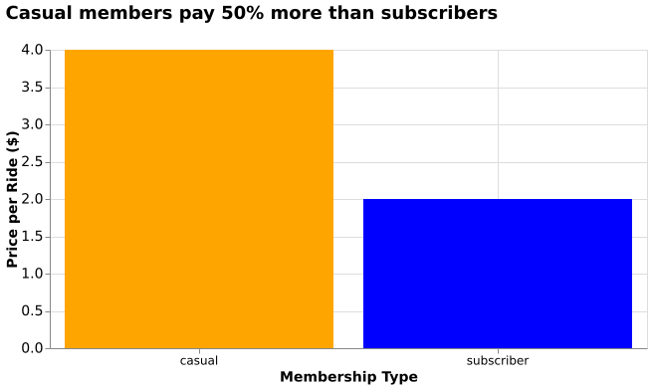
Recommendation on How to Make Personalized Ads to Buy Annual Pass
Consider Customers:
Most of this customer are price incensititive. Or, they just dont realize it! Mention price in our ads.
16

Slide 19
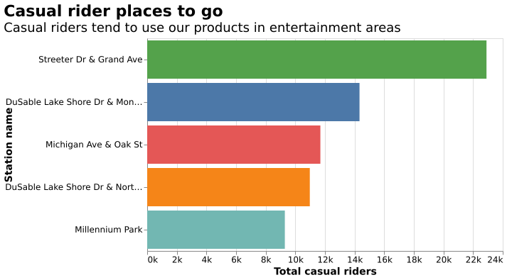
Recommendation on How to Make Personalized Ads to Buy Annual Pass
Consider Customer:
Most of these customers use our products in entertainment area. Collaborate with entertainment business to do ads
17

Slide 20
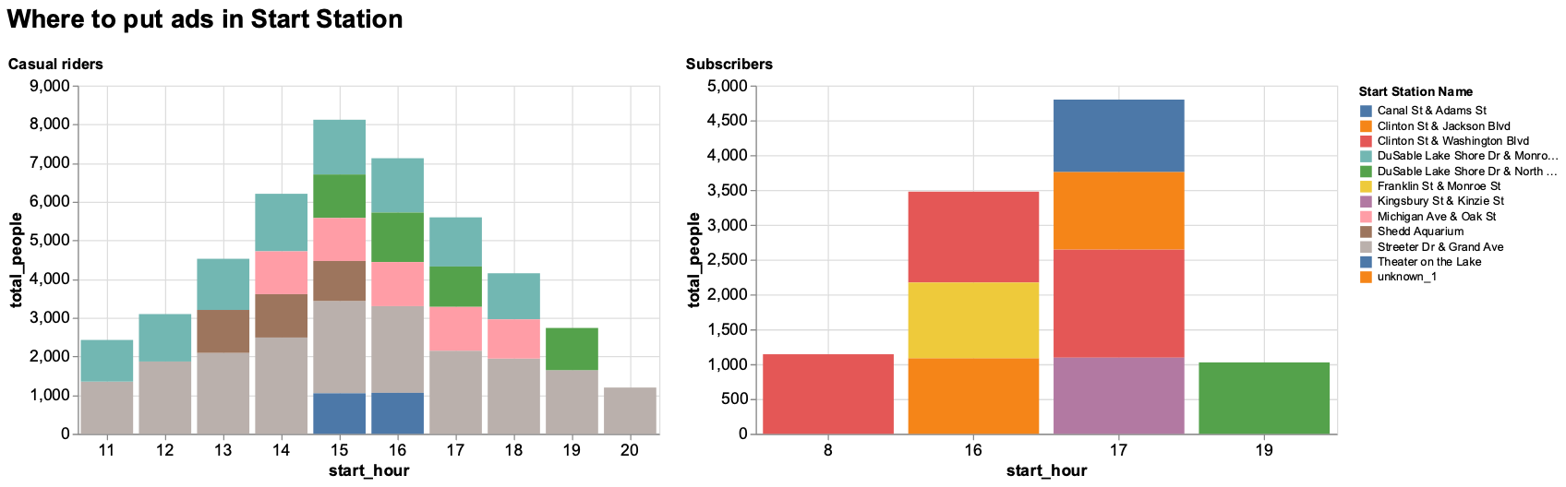
Leverage Geolocation and Time-based Ads on Social Media
Ads targeting casual riders' stations are optimal between 2 pm and 5 pm, while those aimed at subscribers are more effective from 4 pm to 5 pm.
18

Slide 21
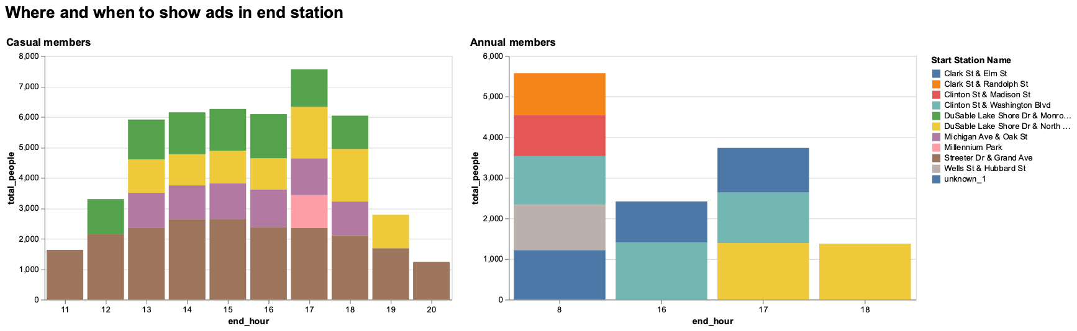
Leverage Geolocation and Time-based ads on Social Media
At the end hours, ads can be targeted to Streeter Dr & Grand Ave since afternoon to evening for casual members whereas for subscribers, ads are more optimized at the rush hours at top locations
19

Slide 22
When & where to do conversion ads
10.15 - 13.00
Streeter Dr & Grand Ave
Dusable Lake Shore Dr & Monroe Street
13.00 - 15.00
Streeter Dr & Grand Ave
Shedd Aquarium
Michiagan Ave & Oak Street
Dusable Lake Shore Dr & Monroe Street
Dusable Lake Shore Dr & Monroe Street
Streeter Dr & Grand Ave
Shedd Aquarium
Michiagan Ave & Oak Street
15.00 - 17.00
Dusable Lake Shore Dr & North Boulevard
Theater on the Lake
Dusable Lake Shore Dr & Monroe Street
Streeter Dr & Grand Ave
Dusable Lake Shore Dr & North Boulevard
Michiagan Ave & Oak Street
17.00 - 19.00
Dusable Lake Shore Dr & North Boulevard
Streeter Dr & Grand Ave
19.00 - 20.15
20

Slide 23
Concluding Remarks
Casual riders and subscribers reveal clear distinctions during Q3
Implement a targeted promotional campaign specifically designed to encourage casual riders to convert into subscribers
Pricing analysis undescores attractiveness of annual membership option
Promote Annual Membership Benefits: Launch a targeted marketing campaign highlighting the advantages and cost-effectiveness of opting for the annual membership
Limited-Time Offer: Introduce a limited-time promotion to incentivize customers to sign up for the annual membership option
Customer type, time, and location can be used for implementing cost-efficient marketing approach to reaching potential subscribers
Targeted Advertising Campaigns: Utilize customer segmentation based on type, time, and location to create personalized advertising campaigns.

Slide 24

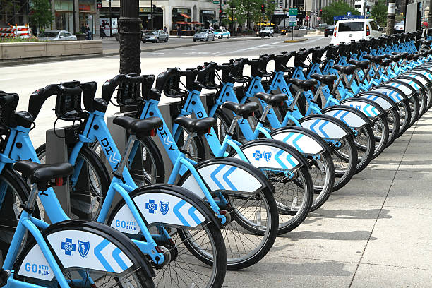


Thank You !
For more about our projects:
github.com/LingAdeu
github.com/FarhanTrinanda
github.com/Brilyawan
github.com/muhammadtofikhidayat
https://github.com/ridhoaryawann

